Slide 1

Improve vehicle road safety by analysing accident data
Rohith Nayak
Sathyanarayana M N
Benny Mathew Kuruvila
George P Abraham
Tarun Kamal Khiani
Capstone Group: 5
Mentor: Neelesh Singh

Slide 2
Agenda
Need to improve vehicle road safety
Objective & Scope – Improve vehicle road safety in the UK
Analytical Approach
Insights on accidents in the UK from 2010-15
Factors influencing serious & fatal accidents in the UK
Future Enhancements

Slide 3
Need to improve vehicle road safety

Slide 4
Devastating impact of Accidents
No. of Causalities across the globe
Average No. of Causalities everyday
Estimated burden on low & mid income families
Leading cause of death
1.25m
3,400
$ 518bn
8th

Slide 5






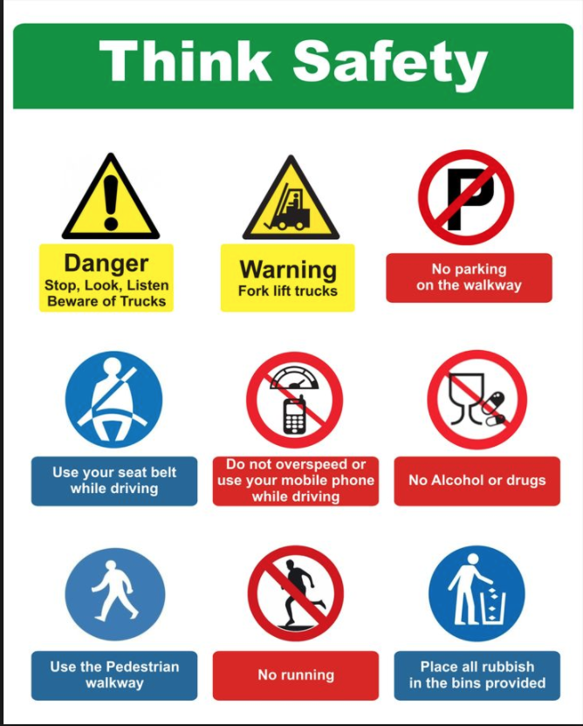
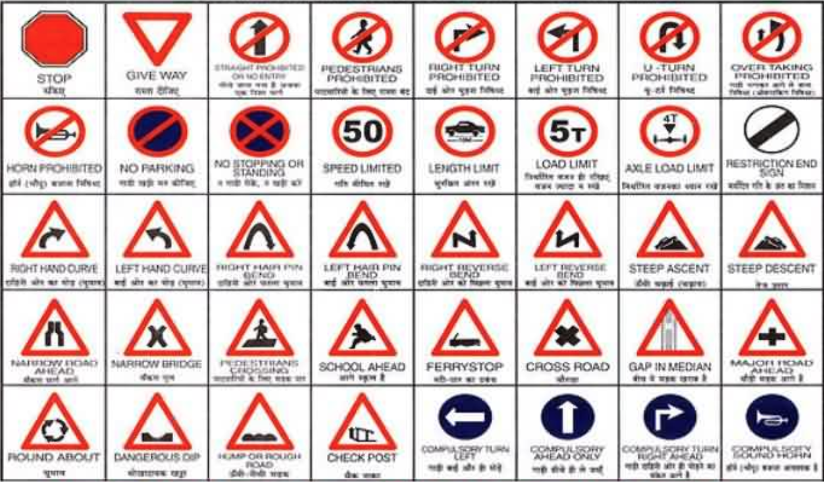
Despite Existing Safety Standards & Procedures

Slide 6
How to address this situation?
Fact based, data driven – Analysing accident data to discover factors and root causes for fatal and serious accidents

Slide 7
Objective & Scope
Improve vehicle road safety in the UK

Slide 8
Objective & Scope
Improve vehicle road safety by understanding factors influencing fatal & serious accidents in the UK and suggesting suitable measures.
Fatal Accident
Serious Accident
Slight Accident
A lost life
Within 30 days
Fractures, Burns…
Requires hospitalization and treatment
Sprain, Cut…
Not requiring medial treatment

Slide 9
Information about accidents in the UK
The UK police forces collect data on every vehicle collision in the UK on a form called Stats19.
Vehicles
Details of all the vehicles involved in an accident
Accidents
Accident records across 2010 to 2015
Causalities
Details of all the casualties involved in an accident
Vehicle Type
Vehicle Manoeuvre
Accident Location
Age of driver
Gender of driver
Engine Capacity
Age of vehicle
Driver in home area or not
Accident Severity
No. of vehicles
No. of causalities
Day & Time of accident
Location
Road Type
Weather Conditions
Light Conditions
Pedestrian Information
Gender of casualty
Age of casualty
Casualty Type
Vehicle Reference
If pedestrian, location/movement/road maintenance worker
Car/Bus Occupant or not
Casualty in home area or not

Slide 10
Analytical Approach
to identify factors influencing fatal & serious accidents

Slide 11
Analytical Approach to identify factors influencing fatal & serious accidents
Data Preparation – store for rich information on an accident
Data Exploration – gain insights on accidents
Variable Selection – to enable right interpretation
Model Building – identify & intepret factors causing fatal & serious accidents
1
2
3
4
Basic data exploration
% of serious & fatal accidents
to arrive at derived variables like vehicle age, engine cc and accident time (early morning, morning,…) in buckets
to understand distribution
Clean & aggregate causalities and vehicles by accident
Merge the causalities & vehicles by accident with the accidents data
Hence a total of 195 variables available for every accident
Explore the rich information on accidents using Tableau
Identify patterns and better understand the situation today
Eliminate variables that directly predict accident severity like no. of serious casualties, no. of fatal causalities,…
Eliminate variables that would not help in predicting like road numbers, time in hours, police visits the accidents spot,…
Dummy encoding
Eliminate unknown variables like `Junction_Control.-1`, `Weather_Conditions.-1`…
Eliminate variables with high multicollinearity
Accident Severity has 3 levels – 1 (Fatal 1.15%), 2 (Serious: 14%), 3 (Slight 84.85%) hence this problem is a multi-class classification problem
One vs Rest strategy – This strategy involves training a single classifier per class, with the samples of that class as positive samples and all other samples as negatives.
Logistic Regression Model – Remove variables that are not significant and have an odds ration less than 1
Evaluate model performance, model robustness
Identify & Interpret factors
R
Tableau

Slide 12
Insights on Accidents in the UK from 2010 to 2015

Slide 13
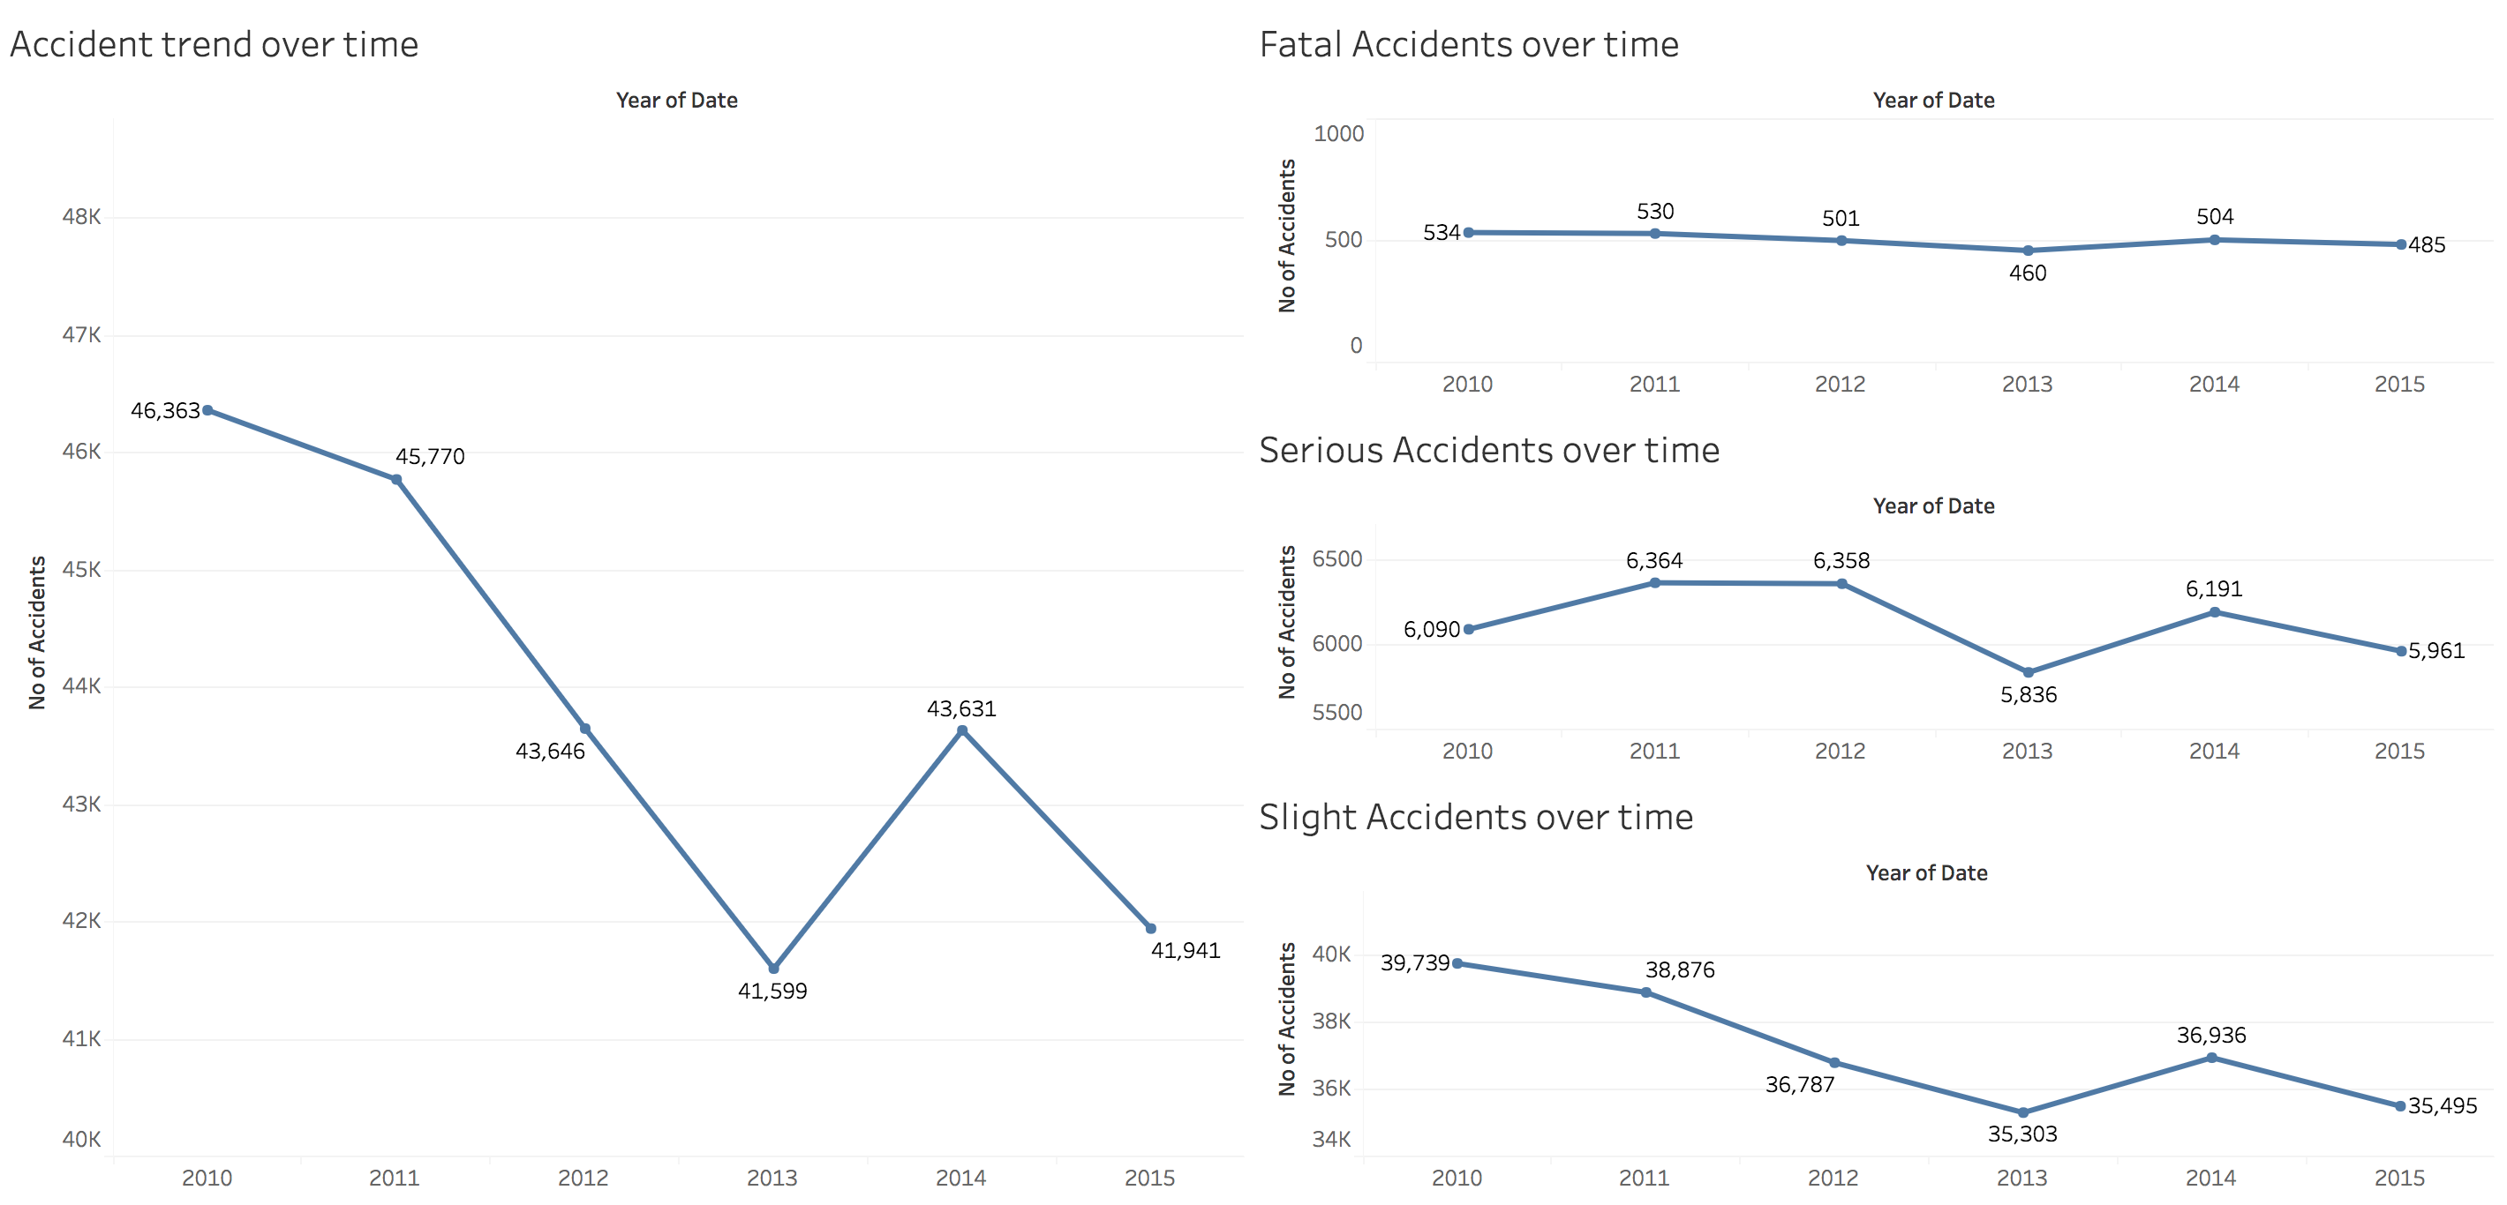
Declining trend of accidents across severity over time except in 2014

Slide 14
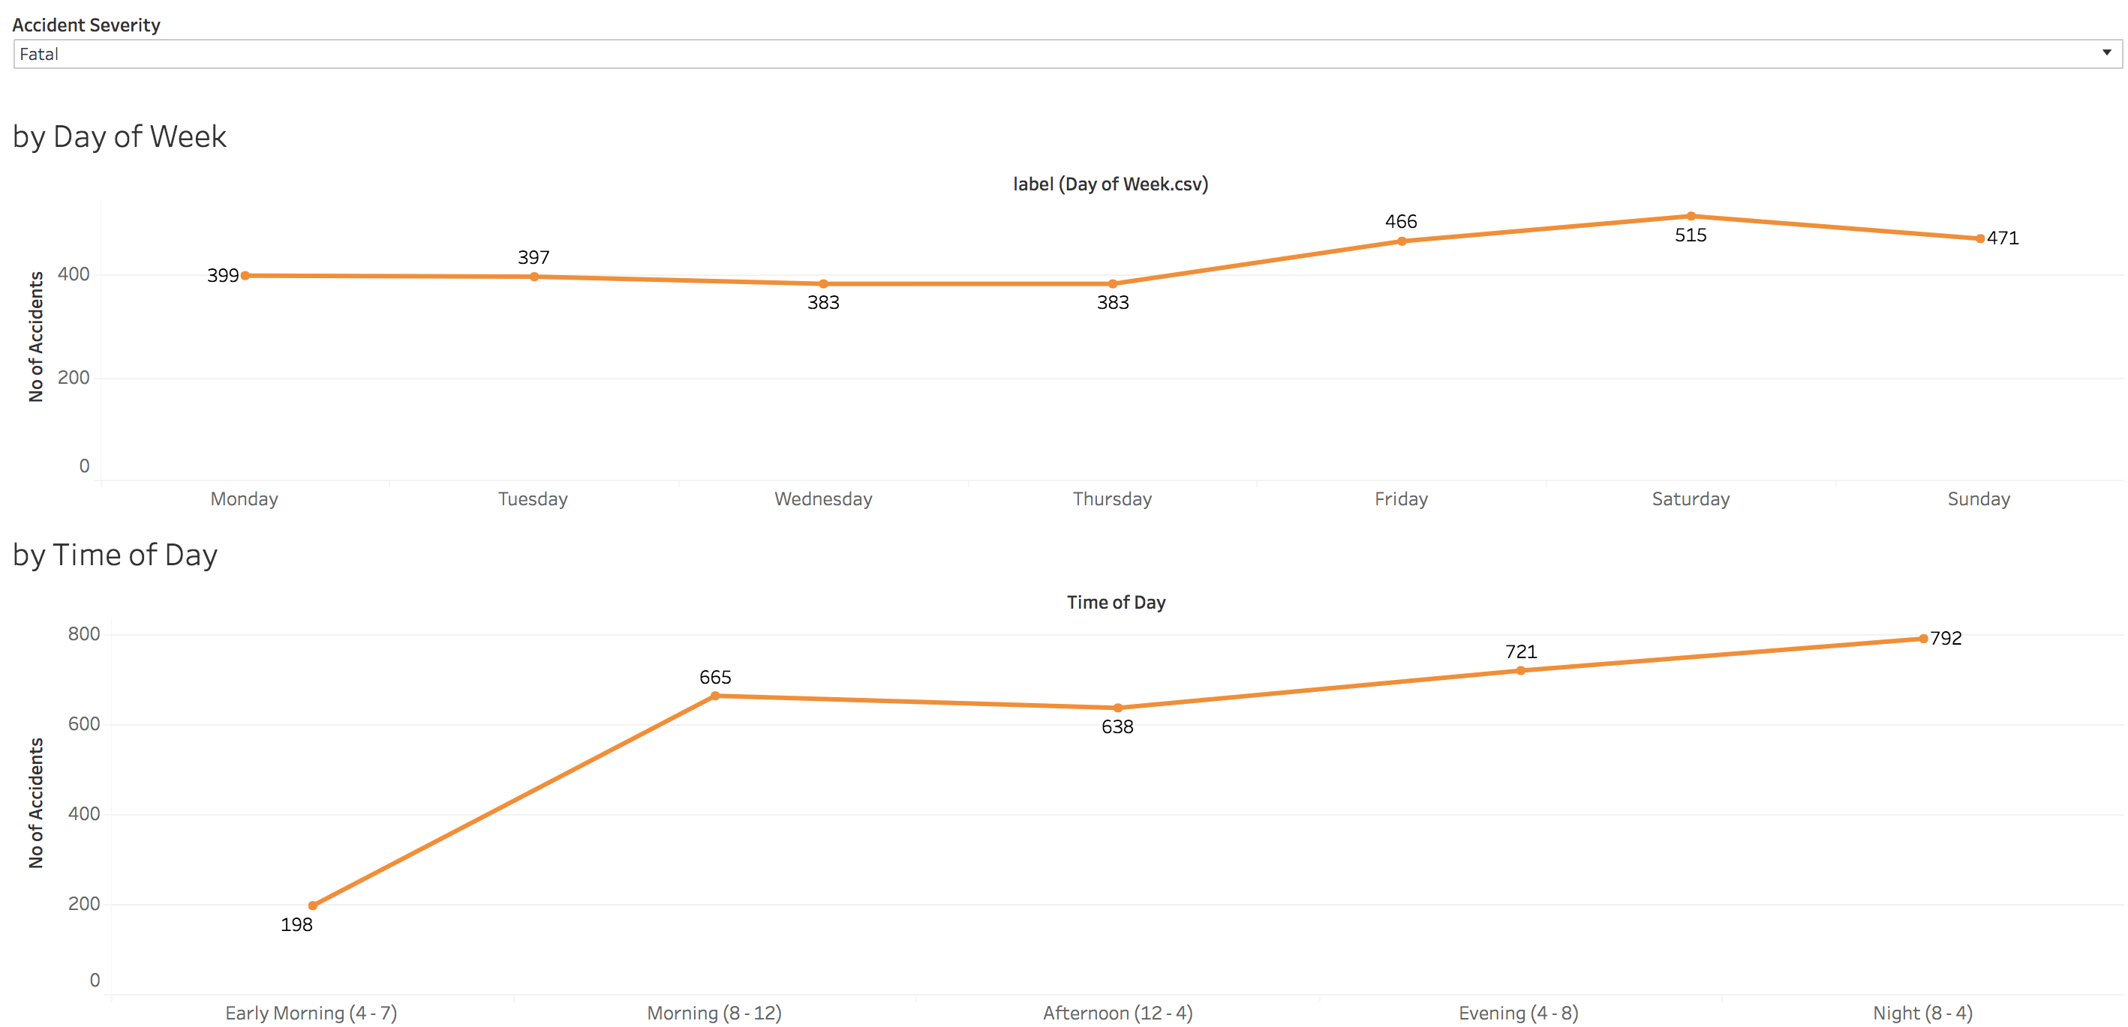
Fatal Accidents peak on Weekends and high numbers are observed from 8:00 PM to 4:00 AM

Slide 15
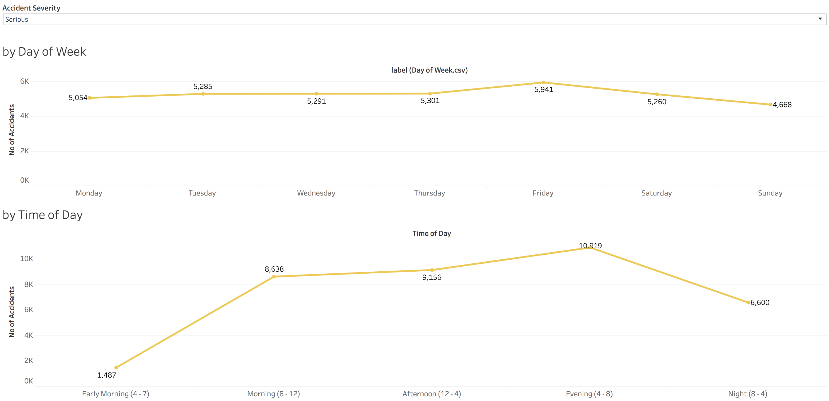
Serious Accidents peak on Fridays and most serious accidents occur from 4:00 PM to 8:00 PM

Slide 16
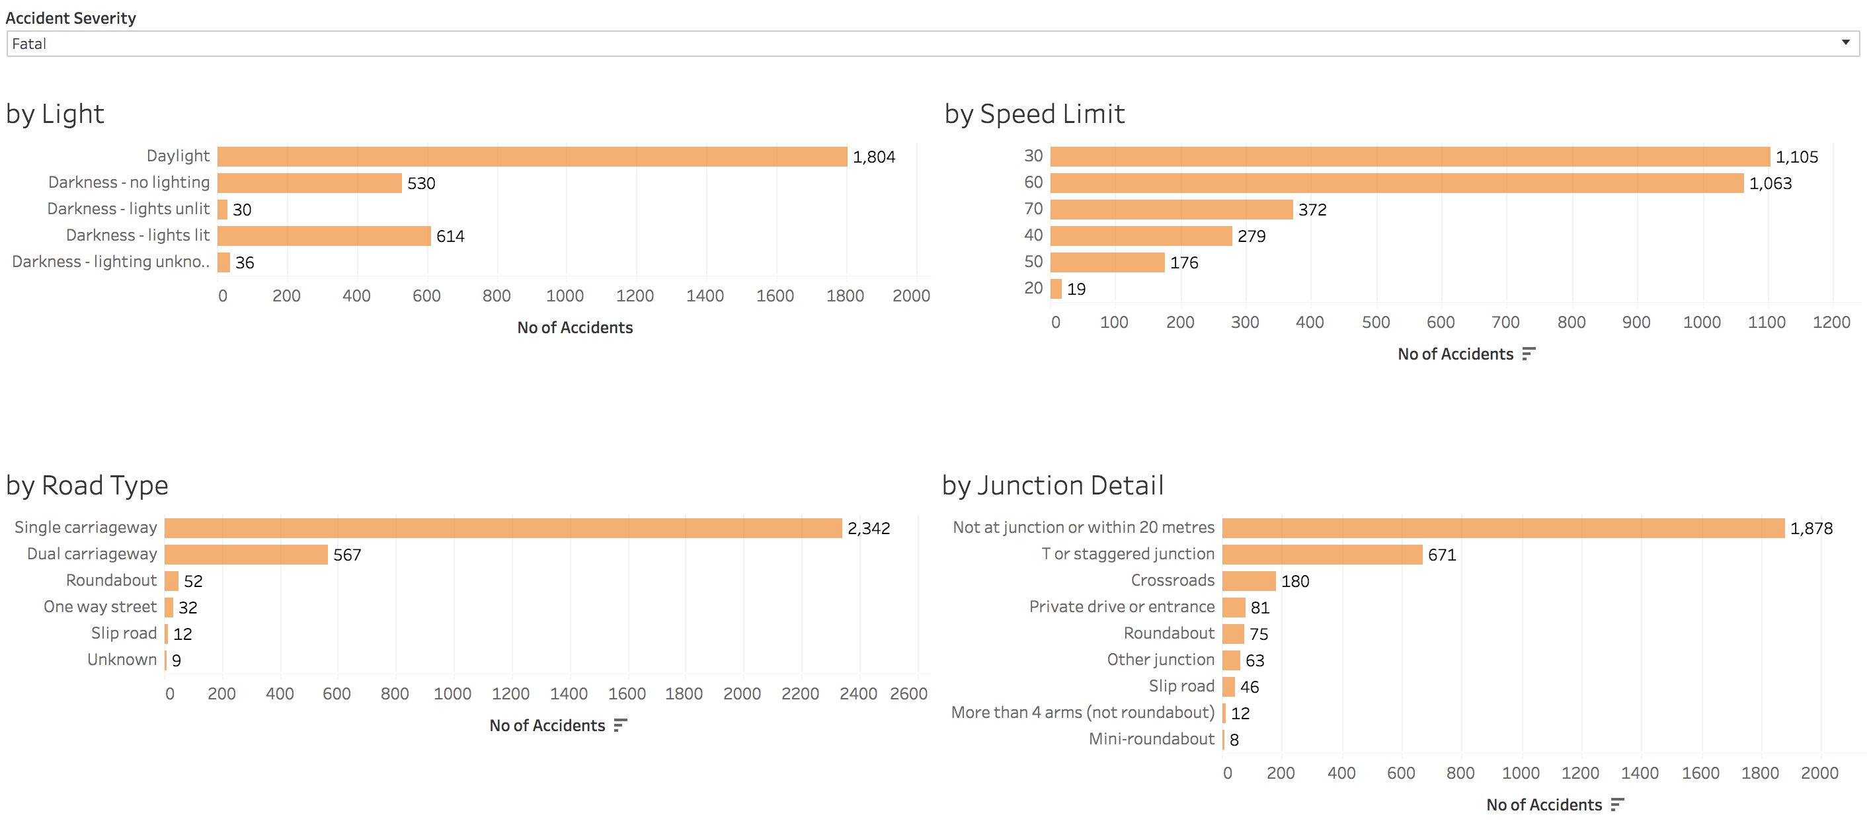
Most Fatal & Serious Accidents occur in daylight, on roads with 30 or 60 as speed limit, on single carriageways and at T/Staggered Junctions or not at a junction

Slide 17
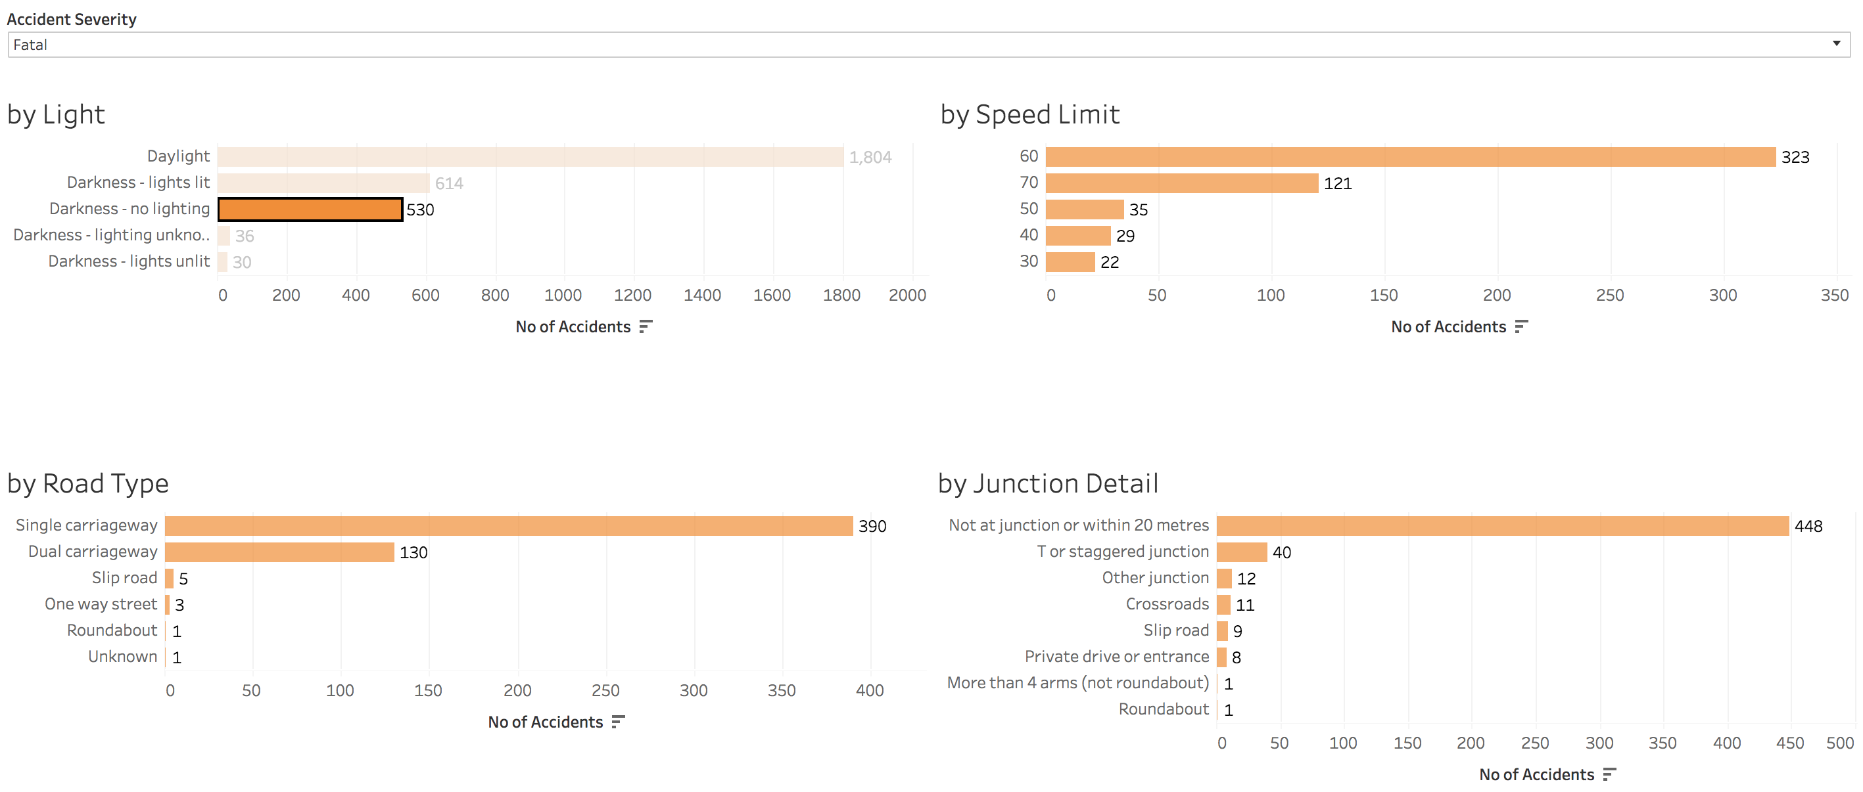
Fatal & Serious Accidents occur at higher speed limits of 60 & 70 in darkness

Slide 18
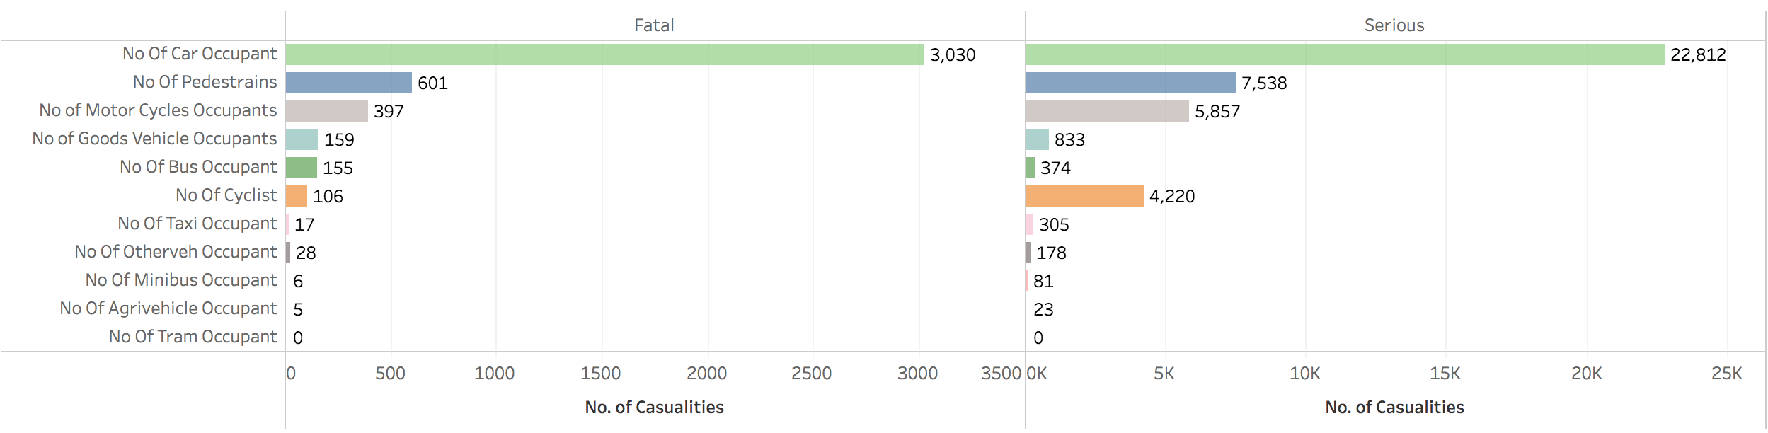
Cars cause the most no. of casualties
Car Occupants, Pedestrians (70%), Cyclist (50%) and Motor Cyclists (50%) are the ones affected

Slide 19
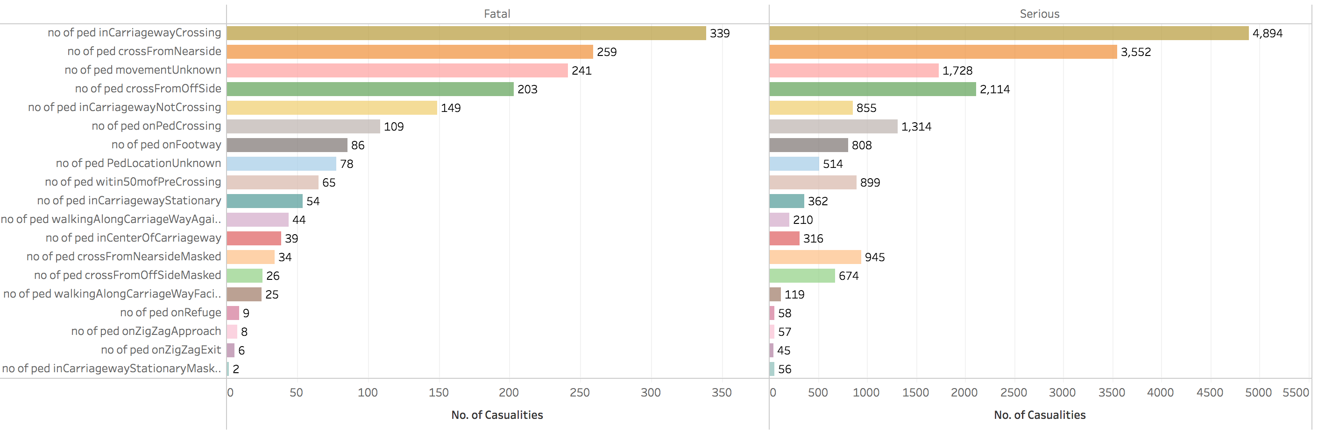
Pedestrians are at high risk and crossing the carriageway, crossing from near side, offside are the primary reason for serious and fatal casualties

Slide 20
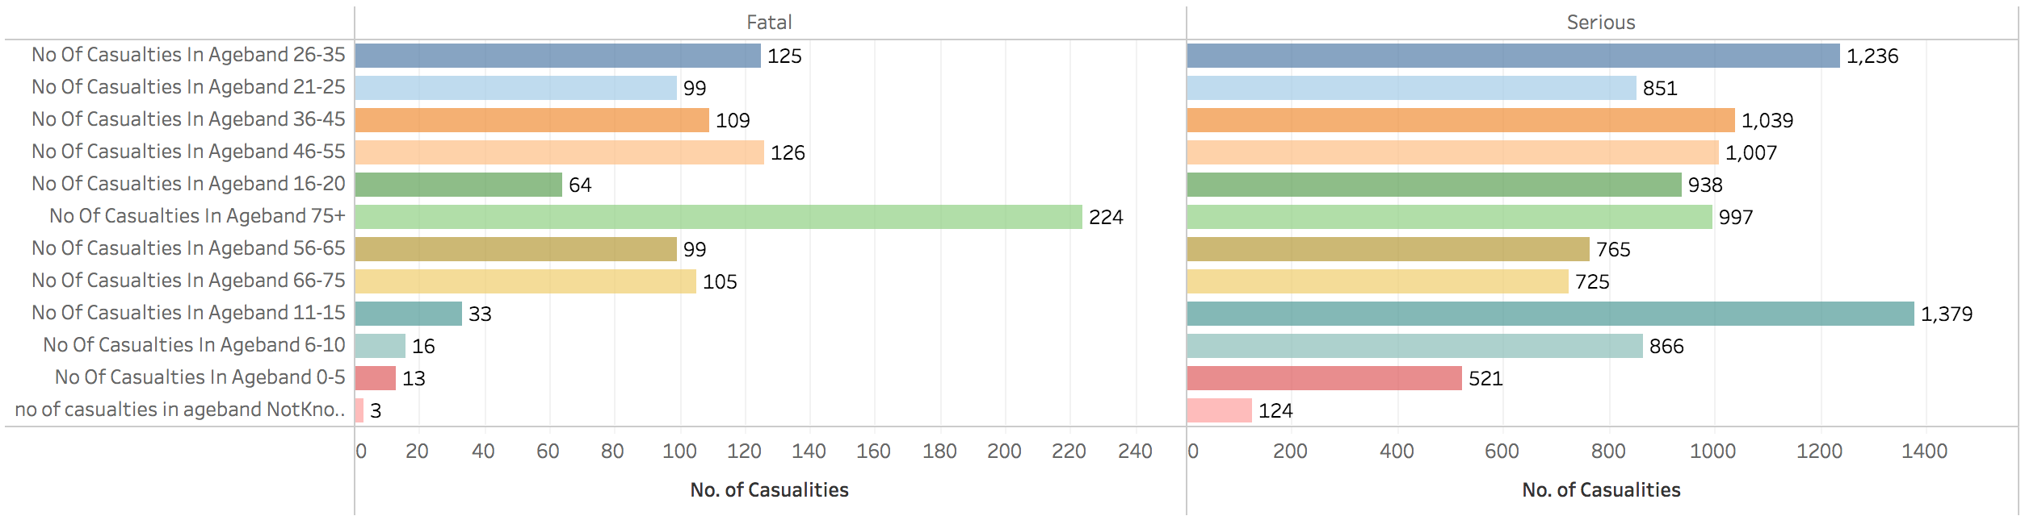
Fatality is high for Pedestrians over 75 years & Serious injuries are prominent for pedestrians in age group 6 – 15

Slide 21
Factors influencing fatal accidents

Slide 22
Model Performance for Fatal Accidents
Model Performance Metric | Score |  | Remarks
 | Train Sample | Test Sample
Overall Significance | 2.2 e^-16 | - | Overall model is significant
McFadden R^2 | 26.22 % | - | 26.22 % of the uncertainty of the intercept only model can be explained by the logistics regression model
AUC | 88.14 % | 86.57 % | Logistics model is robust and strong model
AUC for a 10 fold cross validation | 87.47% - 89.01% | - | Logistics model is robust and it can fair well in new data
Lift at 10th decile | 5.68 | 5.85
Lift at 9th decile | 2.10 | 1.84
% of fatal accidents captured in the 9th & 10th decile | 77.82 % | 76.88 %
Cut-Off | 0.2 | 0.2 | Decided based on the distribution and need to identify fatal accidents
Classification Accuracy | 94.21 % | 96.23 % | Overall accuracy
Sensitivity | 35.45 % | 32.96 % | Reasonable accuracy for fatal accidents
Specificity | 94.21 % | 96.96 % | Reasonable accuracy for non-fatal accidents
Notes:
Factors, Model Performance

Slide 23
Factors influencing Fatal Accidents
Variables | Odds | Interpretation
no_mobilityScooter | 8.25 | If the no. of mobility scooter increases by 1 then the odds to accident fatality increases by 8.25 times
no_of_casualties_in_ageband_11 | 5.44 | If the no of occupants of age over 75 increases by 1 then the odds to accident fatality increases by 5.4
no_of_ped_inCarriagewayNotCrossing | 4.60 | If the pedestrian is in carriageway and are not crossing increases by 1 then accident fatality increases by 4.6
no_motocyle_over_500cc | 4.20 | If the no of motorcycles greater than 500cc increases by 1 then the odds to accident fatality increases by 4.2 times
no_of_ped_onZigZagApproach | 3.60 | If the pedestrian approaching Zigzag increases by 1 then the odds to accident fatal increases by 3.6 times
no_of_ped_crossFromOffSide | 3.37 | If the pedestrian crossing from Offside increases by 1 then the odds to accident fatal increases by 3.37 times
no_goodsVehicleOver7.5t | 3.23 | If the no. of goods vehicles of length over 7.5feet increases by 1, the odds of accident being fatal increases by 3.23 times
no_minibus | 2.97 | If the no. of minibuses increases by 1, the odds of accident being fatal increases by 2.98 times
no_motocyle_under_125cc | 2.91 | If the no. of motorcycles less than 125cc increases by 1 then the odds to accident fatality increases by 2.91 times
no_motocyle_under_500cc | 2.89 | If the no. of motorcycles less than 500cc increases by 1 then the odds to accident fatality increases by 2.89 times
no_agrVehicle | 2.55 | If the no. of agricultural vehicles increases by 1 then the odds to accident fatality increases by 2.55 times
no_of_ped_crossFromNearside | 2.54 | If the pedestrian crossing from nearside increases by 1 then the odds to accident fatal increases by 2.54 times
no_of_cyclist | 2.30 | If the no. of cyclists increases by 1 then the odds to accident fatality increases by 2.31 times
no_goodsVehicleUnder7.5t | 2.20 | If the no. of goods vehicles of length under 7.5feet increases by 1, the odds of accident being fatal increases by 2.2 times
no_of_ped_onZigZagExit | 2.16 | If the pedestrian exiting a zigzag increases by 1 then the odds to accident fatal increases by 2.16 times
no_of_ped_inCenterOfCarriageway | 2.11 | If the pedestrian in centre of carriageway increases by 1 then the odds to accident fatal increases by 2.11 times
no_of_ped_onRefuge | 2.09 | If the pedestrian is a refugee increases by 1 then accident fatality increases by 2.09
no_of_casualties_in_ageband_10 | 2.03 | If the no. of people aged between 66 - 75 involved in casualties increases by 1, the odds of accident being fatal increases by 2.03 times
Light_Conditions.5 | 1.89 | If the light condition is darkness and unlit, the odds of accident being fatal increases by 1.89 times

Slide 24
Recommendations to reduce Fatal Accidents
Fatal Accidents
are more likely in the following situations
Fatal Accidents
Can be reduced by adopting the following measures
Travelling in mobility scooters
People over 65 years of age
Pedestrians
on carriage way and not crossing
on carriageway and crossing
crossing before or after a zig zag junction
Travelling on motor cycles
Travelling in darkness with no street/carriageway with no lighting
Do’s & Don’t for those using mobility scooters and offer a 20-minute course to ensure safety
Advice pedestrians, passengers on mobility scooters, cyclists to dress appropriately to be seen in day or in darkness
Ensure that all streets & carriageways are lit-up when the sun sets
Run an awareness drive for pedestrians once in a year – Walk for a cause and walk safely

Slide 25
Factors influencing serious accidents

Slide 26
Model Performance for Serious Accidents
Model Performance Metric | Score |  | Remarks
 | Train Sample | Test Sample
Overall Significance | 2.2 e^-16 | - | Overall model is significant
McFadden R^2 | 12.41 % | - | 12.41 % of the uncertainty of the intercept only model can be explained by the logistics regression model
AUC | 73.88 % | 73.91 % | Logistics model is robust however it is not a strong model
AUC for a 10 fold cross validation | 73.60 % - 73.91 % | - | Logistics model is robust and it can fair well in new data
Lift at 10th decile | 1.97 | 2.59
Lift at 9th decile | 1.65 | 1.80
% of fatal accidents captured in the first 5 deciles | 73.19 % | 79.60 %
Cut-Off | 0.4 | 0.4 | Decided based on the distribution and need to identify serious accidents
Classification Accuracy | 70.08 % | 74.75 % | Overall accuracy
Sensitivity | 53.63 % | 53.26 % | Reasonable accuracy for serious accidents
Specificity | 78.11 % | 78.25 % | Reasonable accuracy for non-serious accidents
Notes:
Factors, Model Performance

Slide 27
Factors influencing Serious Accidents
Variables | Odds | Interpretation
no_eMotorCycle | 7.96 | If the no. of electric motorcycles increases by 1 then the odds to accident being serious increases by 7.96 times
no_motocyle_over_500cc | 5.71 | If the no. of motorcycles over 500cc increases by 1 then the odds to accident being serious increases by 5.71 times
no_of_ped_crossFromOffSideMasked | 4.18 | If the pedestrian crosses from off side is masked increases by 1 then the odds to accident being severe increases by 4.18 times
no_motocyle_under_500cc | 3.88 | If the no. of motorcycles below 500cc increases by 1 then the odds to accident being serious increases by 3.88 times
no_of_ped_crossFromNearsideMasked | 3.82 | If the pedestrian crosses from nearside is masked increases by 1 then the odds to accident being severe increases by 3.82 times
no_of_ped_crossFromOffSide | 3.19 | If the pedestrian crosses from off side increases by 1 then the odds to accident being severe increases by 3.19 times
no_motocyle_under_125cc | 3.19 | If the no. of motorcycles below 125cc increases by 1 then the odds to accident being serious increases by 3.19 times
no_of_cyclist | 3.07 | If the no. of cyclists increases by 1 then the odds to accident being serious increases by 1.12 times
no_of_ped_crossFromNearside | 3.02 | If the pedestrian crosses from nearside increases by 1 then the odds to accident being severe increases by 3.02 times
no_of_casualties_in_ageband_11 | 2.62 | If the no of occupants of age over 75 increases by 1 then the odds to accident being serious increases by 2.6
no_of_ped_onZigZagExit | 2.46 | If the pedestrian exiting a zigzag increases by 1 then the odds to accident being serious increases by 2.46 times
no_motocyle_under_50cc | 2.42 | If the no. of motorcycles below 50cc increases by 1 then the odds to accident being serious increases by 2.42 times
no_of_ped_inCarriagewayNotCrossing | 2.22 | If the pedestrian in carriageway and are not crossing increases by 1 then the odds to accident being severe increases by 2.22 times
no_mobilityScooter | 2.22 | If the no. of mobilityscooter increases by 1 then the odds to accident being serious increases by 2.22 times
no_of_agrivehicle_occupant | 2.05 | If the no. of agricultural vehicles increases by 1 then the odds to accident being serious increases by 2.05 times
no_of_ped_onFootway | 1.93 | If the pedestrian on the footway increases by 1 then accident being serious increases by 1.93 times
no_of_casualties_in_ageband_10 | 1.92 | If the no. of people aged between 66 - 75 involved in casualties increases by 1, the odds of accident being severe increases by 1.92 times

Slide 28
Recommendations to reduce Serious Accidents
Serious Accidents
are more likely in the following situations
Serious Accidents
can be reduced by adopting the following measures
Commuters in Electric Motor Cycles
Motor Cycle Riders
Heavy motorcycle users (>500cc)
Middleweight motorcycle users (>300cc)
Pedestrians
crossing from onside or offside irrespective of being masked or unmasked
exiting a zigzag
Cyclists
Electric Motor Cycles
Drivers test should be mandatory for electric motorcycles that has a motor of 250 watts output or less.
License should be mandatory for a motor greater than 250 watts.
Motor Cycle Riders
Users riding without rider gear (not limited to helmets), should be considered as a violation of traffic rules
Campaigns promoting best road practices, safety gear usages
Cyclists
Strictly advised to use only bike lanes. Violators should be penalized.
Usage of proper rider gear and first aid kit should be promoted among cyclists.

Slide 29
Future Enhancements
Different models for different casualty types. This would further help in identifying patters specific to the casualty type.
Model to consider interaction between variables. This would help in identifying hidden patterns on how a combination of variables make an accident fatal or serious.
Challenging the logistics regression model with a RF, SVM or similar.

Slide 30
Learn More
Detailed report on the accident data
Tableau Dashboard for detailed Insights on Accidents in the UK from 2010 – 2015
GitHub for the r-code for UK accident data analysis
Data at different stages (processed data)

